Slide 1


Spatially explicit population modelling
Damaris Zurell, Anne Malchow
https://damariszurell.github.io
@ZurellLab
Pictures from www.undekade-biologischevielfalt.de
Notes:
1

Slide 2
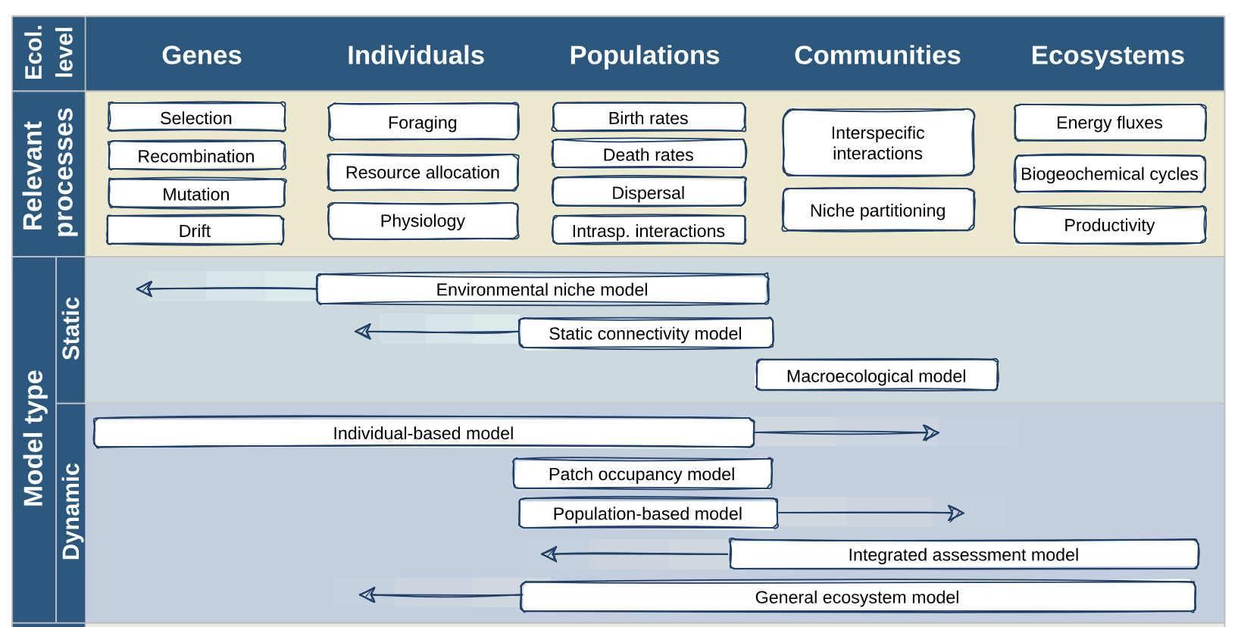
Spatially explicit models in conservation
Static and correlative niche models over-represented in literature …
Zurell et al. (2021) Ecography. DOI: 10.1111/ecog.05787.

Slide 3


Species respond dynamically to global change
Habitat becoming suitable but not colonisable
Six key mechanisms for predicting biodiversity response:
Species interactions
Adaptation
Dispersal
Environment
Habitat becoming suitable and colonisable
Demography
Physiology
Current distribution
partly becoming unsuitable
Ferrier et al. Eds (2016) IPBES.
Urban et al. (2016) Science 353: aad8466.

Slide 4
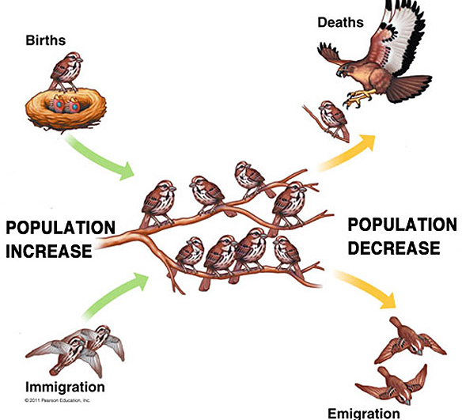
Spatially explicit population models
Provide a more process-explicit understanding, e.g.:
Which factors determine population dynamics and range margins?
How will fragmentation affect gene flow between populations?
How fast can species recover from population crashes or (re)colonise landscapes?
…
2011 Pearson Education Inc.

Slide 5
Spatially explicit population models
Predict viability of populations, communities, and ecosystems
Define temporally explicit conservation & restoration objectives
Adapted from Zurell et al. (2021) Ecography. DOI: 10.1111/ecog.05787.

Slide 6

Spatially explicit population models
Simulating local population dynamics and dispersal
Local population dynamics described by population model, e.g. logistic growth or matrix population model
Dispersal described by dispersal kernel or movement simulator
Landscape can be described as patch-matrix landscapes, patch types of different quality, of grid cells of different quality

Slide 7
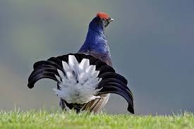
Spatially explicit population models
Example: black grouse in Switzerland
Stage-structured model, individual-based movement decisions
2001
2050
2100
Zurell et al. (2012) Ecography 35: 590-603.

Slide 8
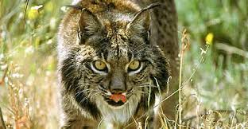
Spatially explicit population models
Example: Iberian lynx
Stage-structured model, dispersal kernel
Climate change:
Management intervention:
Fordham et al. (2013) Nature Clim Ch 3: 899-903.

Slide 9
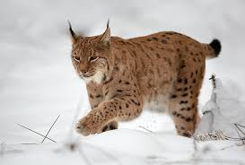
Spatially explicit population models
Example: Eurasian lynx, reintroduction Scotland
Stage-structured model, individual-based movement decisions
Aberdeenshire
Kintyre Peninsula
Keilder Forest
Ovenden et al. (2019) Biol Cons 234: 140-153.

Slide 10
Spatially explicit population models
Example: Caucasian leopard
Stage-structured model, individual-based movement decisions
Bleyhl et al. (2021) Ecol Appl.

Slide 11


Thank you for your interest
Contact:
Damaris Zurell
Ecology & Macroecology
University of Potsdam
https://damariszurell.github.io
Email: damaris.zurell@uni-potsdam.de
@ZurellLab

